Slide 1
FMDs: Forecasting Global Trends in Mental Health Disorders
Foundation of Data Science Project

Slide 2
TABLE OF CONTENTS
01
02
03
04
Introduction
Methodology
Results
Conclusion

Slide 3
01
Introduction

Slide 4
INTRODUCTION
Mental health disorders affect a growing number of people globally, often leaving many untreated and marginalized.
Use of artificial intelligence (AI) to forecast future prevalence of mental disorders.

Slide 5
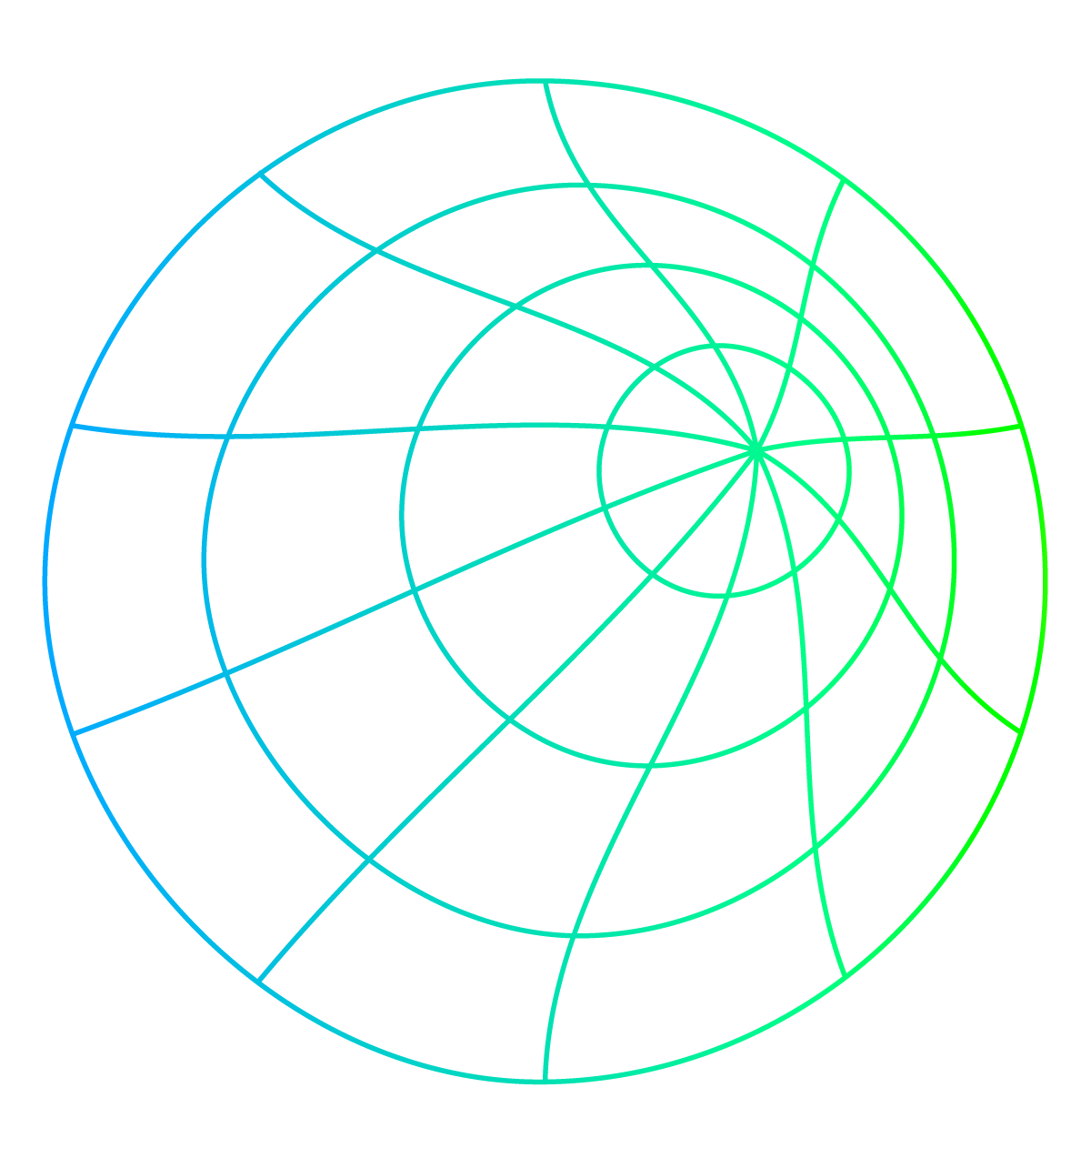
Data-Set Disorders
Depression
Anxiety
Bipolar
A mood disorder characterized by persistent sadness and feelings of worthlessness.
A mental health condition causing excessive worry and fear.
A mental illness causing extreme mood swings from mania to depression.
Eating Disorders
An unhealthy relationship with food that can lead to obsession with weight or body image.
Schizophrenia
Drug Use
Alcholism
A chronic and severe mental disorder that affects how a person thinks, feels, and behaves.
The repeated use of a substance (other than prescribed medication) that alters mood or behavior.
A chronic and severe condition characterized by excessive and uncontrolled drinking.

Slide 6
02
Methodology

Slide 7
Models used
Holt-Winters Exponential Smoothing
Autoregressive Integrated Moving Average
Moving Average
Autoregressive Model
Recurrent
Neural Networks
Long Short-Term Memory

Slide 8
03
Results

Slide 9
Best Performing Models Per Mental Disorder
Disorder | Dataset 1 | Dataset 2 | Dataset 3
Depression | ARIMA | HWES | LSTM
Anxiety | HWES | ARIMA | ARIMA
Bipolar | MA | HWES | HWES
Eating | ARIMA | HWES | LSTM
Schizo | ARIMA | HWES | HWES
Drug use | NA | ARIMA | ARIMA
Alcohol | NA | ARIMA | ARIMA

Slide 10
04
Conclusion

Slide 11
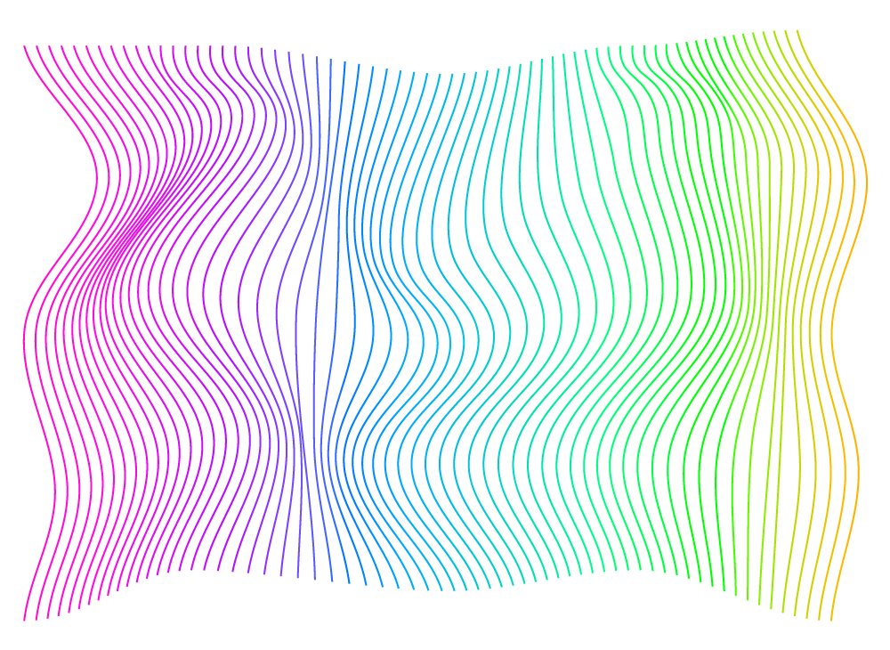
IN CONCLUSION
It was found that on average throughout the datasets and disorders Holts Winters Exponential Smoothing (HWES) alone was the best perfoming model closely followed by the Auto-Regressive Integerated Moving Average (ARIMA) as the most frequent best model.

Slide 12
Thank
you

